Slide 1

Introduction to Computer Science
By Mohamed Essam
mhmd96.essam@gmail.com

Slide 2
INTRODUCTION TO COMPUTING
Computers have become a ubiquitous feature of modern life. It would be difficult to get through a day without some activity involving a computer, be it composing e-mail on a computer sitting on a desk, using a computer hidden inside a cell phone, or receiving a bill generated by a computer at the power company. Computer science allows all these activities to happen.

Slide 3
INTRODUCTION TO COMPUTING
A computer is an electronic device for performing logical and mathematical operations based on its programs. The term includes not only the obvious electronic devices that have a screen, keyboard, printer, and so on, but also computers that are embedded into devices like those at supermarket checkout counters or in DVD players. What makes computers interesting and powerful is that they can be given arbitrary sets of instructions to perform.

Slide 4
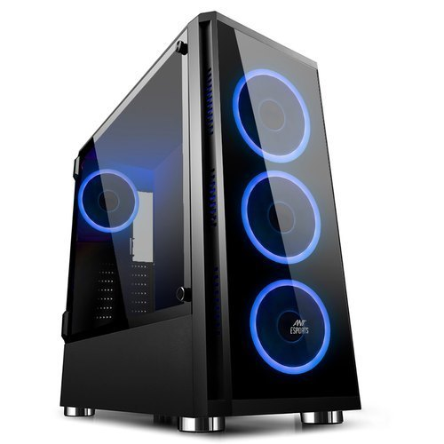
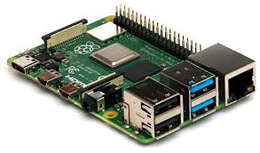
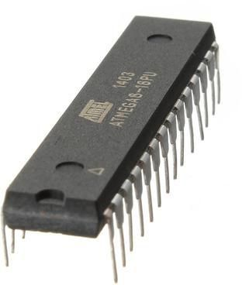
Example of different kinds of computers

Slide 5
But what is computer science?
It sounds simple enough—computer science is a branch of science that studies computers. But not everyone who works with computers is a computer scientist. The use and development of computers comprises a number of overlapping disciplines.
Notes:
يتألف استخدام وتطوير أجهزة الكمبيوتر من عدد من التخصصات المتداخلة.

Slide 6
What is a program?
A program is a series of steps to accomplish a given task. In general usage, a program might refer to everyday instructions, written in English, such as instructions to change a tire or register for a college class. In computer science, however, the term “program” refers to a series of steps given to a computer.

Slide 7
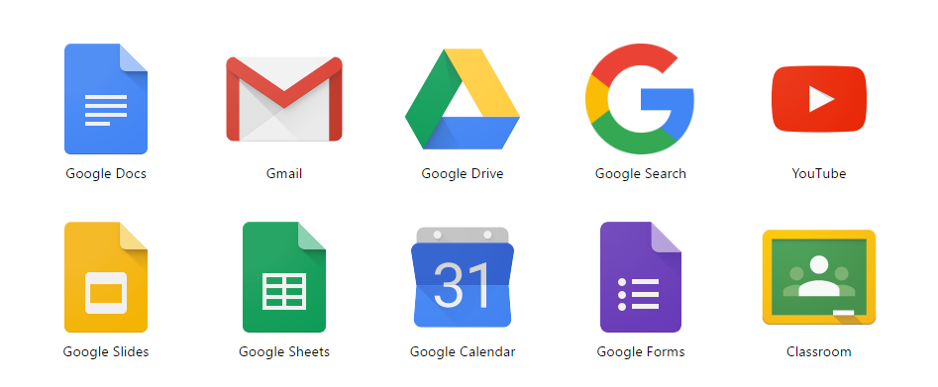
What is a program?

Slide 8
What is a program?
A program is a series of steps to accomplish a given task. In general usage, a program might refer to everyday instructions, written in English, such as instructions to change a tire or register for a college class. In computer science, however, the term “program” refers to a series of steps given to a computer.

Slide 9
What is a Hardware?
Hardware refers to all the physical devices that make up a computer system, both those inside the computer “case” and those outside the case, like monitor, keyboard, and mouse.

Slide 10
What is a Software ?
Software refers to the programs the computer executes. For example, the word processor Microsoft Word, or the computer game “Half-Life,” is software, as is a program that enables a cell phone display so the user can select a new ring-tone. By analogy, when you play a movie in a DVD player, the movie is the software and the player is the hardware.

Slide 11
What is a Programmer ?
A programmer is someone who creates programs.

Slide 12
What computer Science about?
Computer science is about Problem solving

Slide 13
inputs →
→ outputs

Slide 14
algorithms

Slide 15
What Algorithm is?
An algorithm is a set of instructions for solving a problem or accomplishing a task.
common example of an algorithm is a recipe

Slide 16
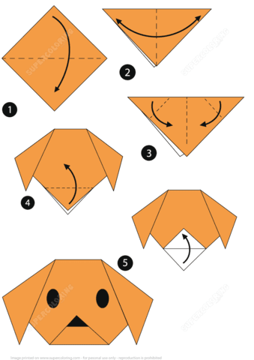
algorithms

Slide 17
algorithms

Slide 18
The Abacus
The first efforts toward mechanical assistance aided in counting, not computation. An abacus is a mechanical device with beads sliding on rods, which is used as a counting device. It dates to at least the Roman Empire, and its ancestor, the counting board, was in use as far back as 500 B.C. The abacus is considered a counting device because all the computation is still done by the person using the device. The abacus did show, however, that a machine could be used to store numbers.

Slide 19
The Abacus

Slide 20
decimal
0, 1, 2, 3, 4, 5, 6, 7, 8, 9
Decimal
0, 1, 2, 3, 4, 5, 6, 7, 8, 9
Base 10
Base 10

Slide 21
decimal
0, 1, 2, 3, 4, 5, 6, 7, 8, 9
1 2 3
Base 10

Slide 22
decimal
0, 1, 2, 3, 4, 5, 6, 7, 8, 9
100 10 1
1 2 3
Base 10

Slide 23
100 10 1
1 2 3
1x100 + 2x10 + 3x1
Base 10

Slide 24
Binary System
Computers are electronic machines. Essentially everything they do involves turning electrical switches off or on. It’s difficult at first to imagine that everything computers are capable of grows from this basic principle. To see how, you need to understand the concept of a binary system.

Slide 25
Binary System
Binary means having two states. In the computer’s case, the two states are off or on. The trick to understanding binary is seeing how a series of these “off” and “on” states can represent any data you can think of.

Slide 26
4 2 1
1 1 1

Slide 27
Registers
1 | 2 | 4 | 8 | 16 | 32 | 64 | 128
1 | 0 | 1 | 0 | 1 | 0 | 1 | 0
“Byte”

Slide 28
Bytes and bit
bits and bytes are both units of data, but what is the actual difference between them? One byte is equivalent to eight bits. A bit is considered to be the smallest unit of data

Slide 29
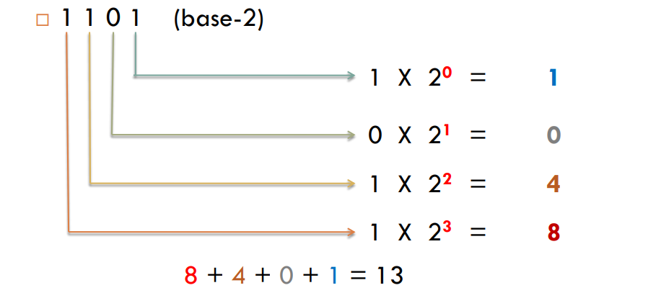
Binary-to-Decimal Conversion

Slide 30
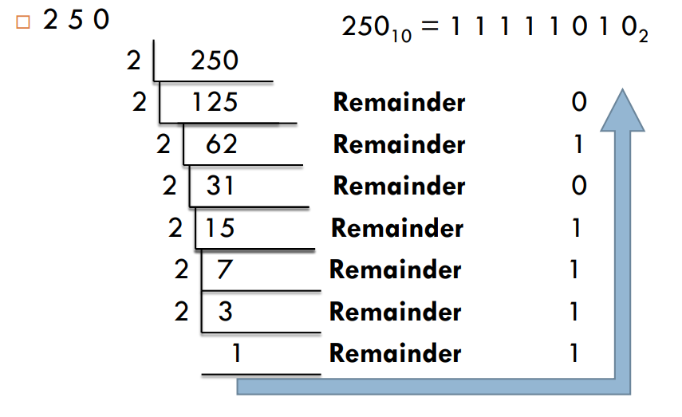
Decimal-to-Binary Conversion (positional number)

